Slide 1
The Simpsons Characters
Sijie Huang, Hanying Shen
Notes:
太难了！

Slide 2
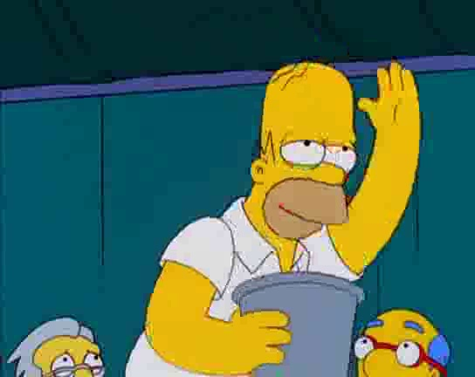
1. Ask a Question
Simpson character image dataset
To distinguish the characters of Homer Simpson and Lisa Simpson
Use CNN and Transfer Learning to do the binary image classification

Slide 3
2. Get the data.
Kaggle: https://www.kaggle.com/alexattia/the-simpsons-characters-dataset
42 classes with 20933 images
Homer Simpson: 2247 images
Lisa Simpson: 1354 images
Data cleaning: add labels to images before training the model
Related dataset: test set (to test the model at the end)

Slide 4
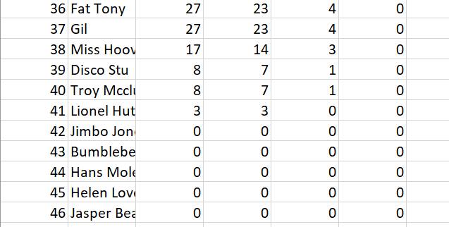
3. Explore the Data
Problem with data?
The original dataset has 42 classes, and many of them have less than 100 images
Too many classes will lead to less accuracy
How to improve this dataset in the future?
Capture more images
Reduce to less classes

Slide 5
4. Model the Data
Image dataset → CNN and Transfer Learning, SVM
Accuracy: Training and Validation Loss, Confusion Matrix, ROC
Notes:
The main idea of principal component analysis (PCA) is to reduce the dimensionality of a data set consisting of many variables correlated with each other, and we keep 50 components to accelerate ML algorithms
Also used StandardScaler is to transform the data

Slide 6
5. Select a model and train it.
Random Forest Classifier
SVM (Support Vector Machine)
CNN
Transfer Learning
Notes:
Random Forest is a large number of relatively uncorrelated models (trees) operating as a committee will outperform any of the individual constituent models.
SVM is given labeled training data (supervised learning), the algorithm outputs an optimal hyperplane which categorizes new examples.
CNN stands for Convolutional neural network, It takes input images, process it and classify it under certain categories. In our project, we input 3601 homer and lisa image and classify them into their own character categories.
Transfer learning is a process to fine-tune the neural network and we apply VGG16 model for this step.

Slide 7
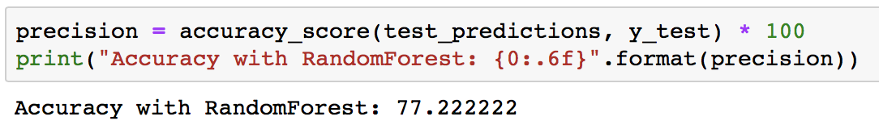
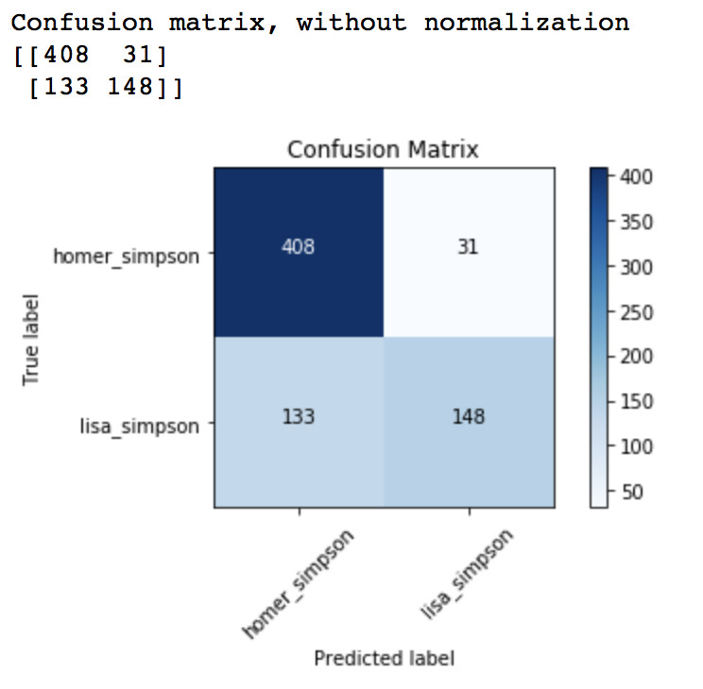
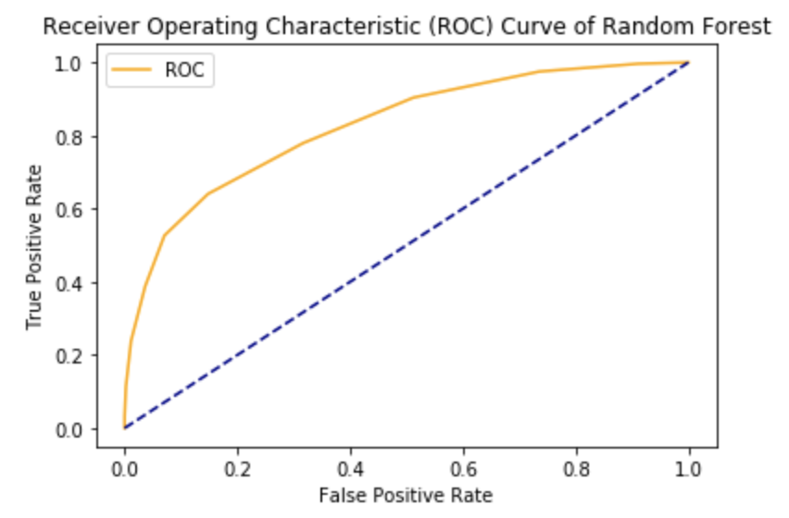
Random Forest Classifier
AUC test score: 0.73
Notes:
ROC is a probability curve and AUC represents degree or measure of separability. It tells how much model is capable of distinguishing between classes. Higher the AUC, better the model is at predicting 0s as 0s and 1s as 1s.
133 false positive, and 31 false negative
Model predicts 133+408=541 as Homer, and 31+148=179 as Lisa, 133+31=164 classifications were incorrect. 720 test images

Slide 8
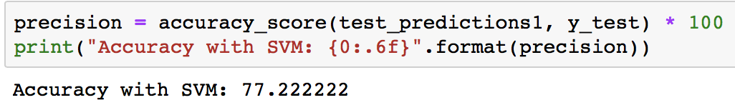
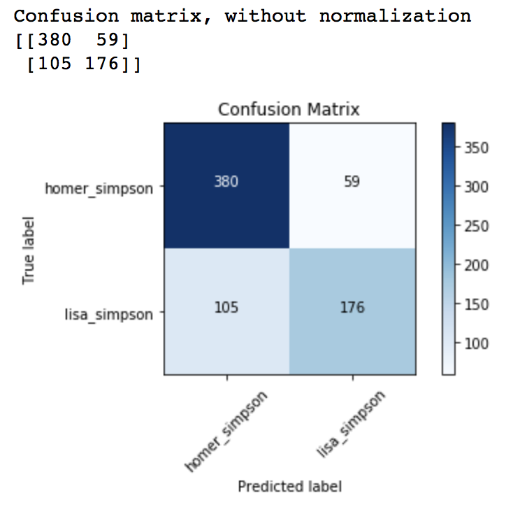
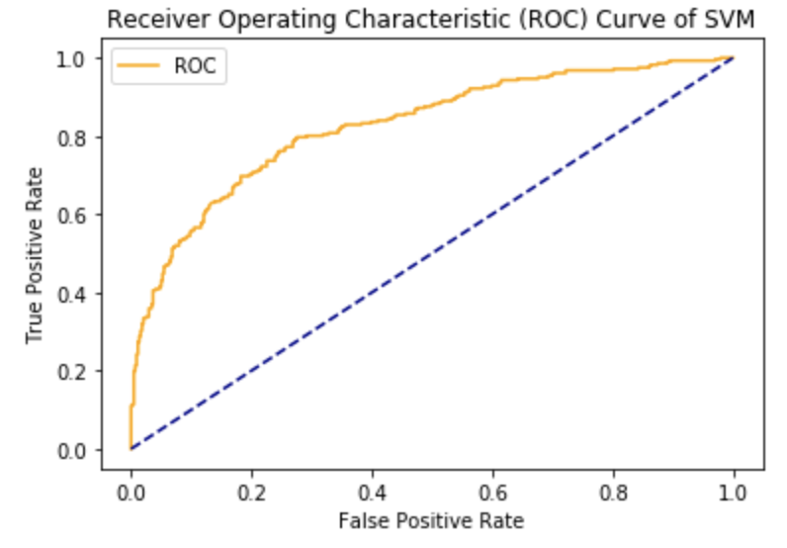
SVM (Support Vector Machine)
AUC test score: 0.75
Notes:
105 false positive, and 59 false negative
AUC increased by 2%

Slide 9
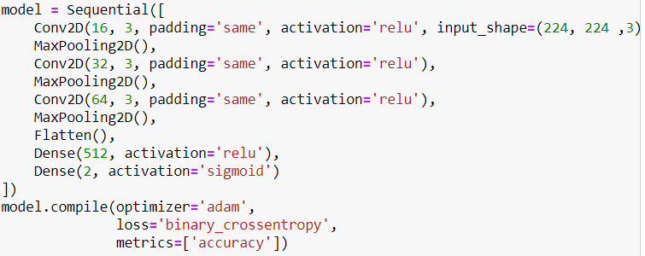
CNN
Notes:
We build a CNN model, and it have 5 epochs as showing here.
1.To build the model we need to create the architecture using Sequential()
2.Next we add the first layer, a convolution layer to extract features from the input image, and create 16 3 ReLu convoluted features also known as feature maps. Since this is the first layer we must input the dimension shape which is a 224 x 224 pixel image with depth = 3
3.The next layer will be a pooling layer pixel filter to get the max element from the feature maps. This reduces the dimension of the feature maps by half and is also known as sub sampling.
4.Create two more convolution layer with 32 and 64 features and pooling layer like before, but without the input_shape
5.Add a flattening layer, to reduce the image to a linear array also known as a one 1-Dimension vector to feed into and connect with the neural network.
6.Now create a neural network where the first layer has 512 neurons and the activation function ReLu.
7.Create the last layer of this neural network with 2 neurons (one for each label) using the sigmoid function.
8.So the CNN should look like below when put together.
Compile the model.Give it the binary_crossentropy loss function which is used for 2 classes, the adam optimizer, and the accuracy of the model.

Slide 10
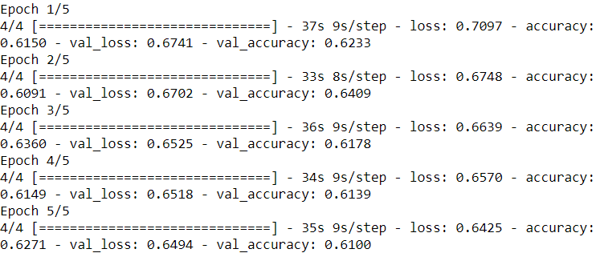
Notes:
Train the model using the fit() method, which is another word for train. We will train the model on the training data with batch size equal to 700 and batch size for validation=100, epochs =5
From the output we can see the accuracy are around 60% and the loss are higher than 65%.
The highest accuracy for train is 63.6%, for validation is 64.09%

Slide 11
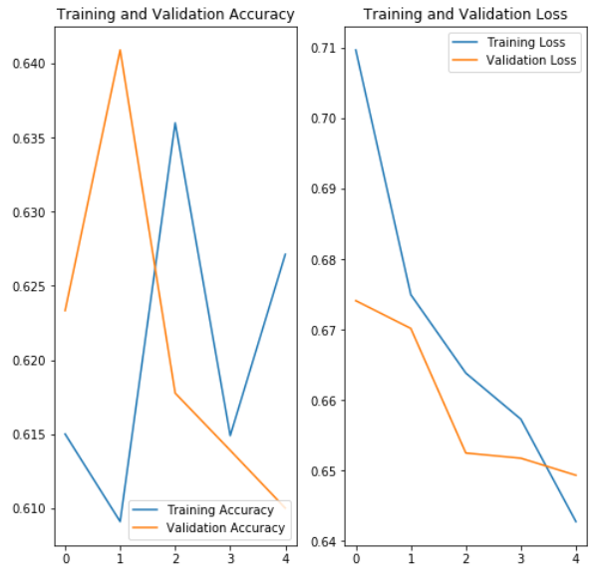
Notes:
Visualize the models accuracy and loss for both the training and validation data.
The trend of accuracy for both the training and validation are going up first and then going down.But the loss is generally decreasing and interact and spreading further apart later.
Because the model has some problems, we use multiple ways to fight in the training process.

Slide 12
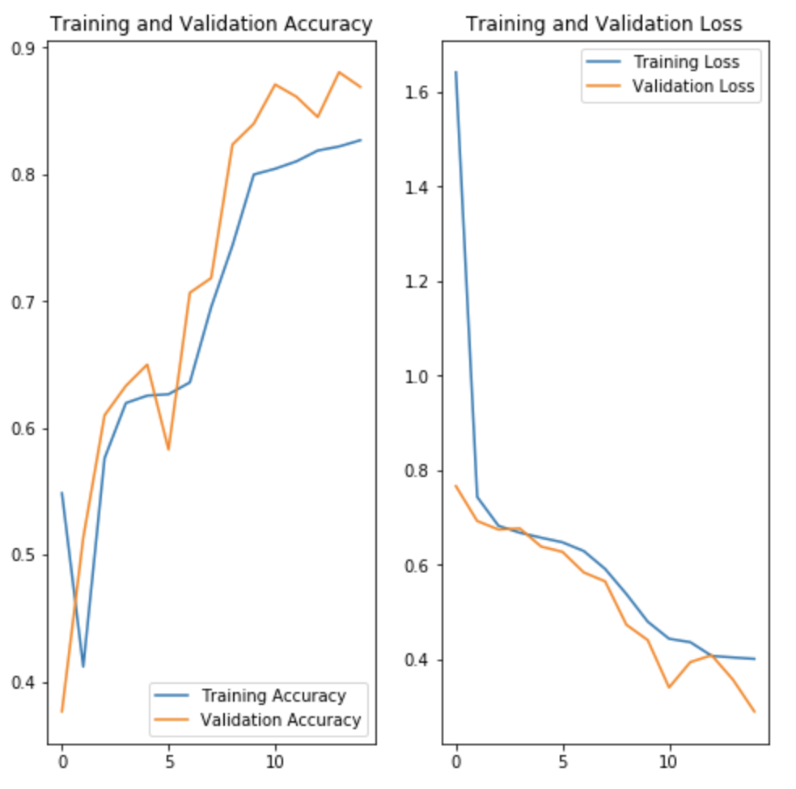
Notes:
To fix the problem, we first apply horizontal flip.
We Pass horizontal_flip as an argument to the ImageDataGenerator class and set it to True to apply this augmentation.
Increase epoches from 5 to 15, so both accuracy and loss are more correct but it still occurs interactition for the accuracy and spread further apart for the loss so we keep trying more transformations.

Slide 13
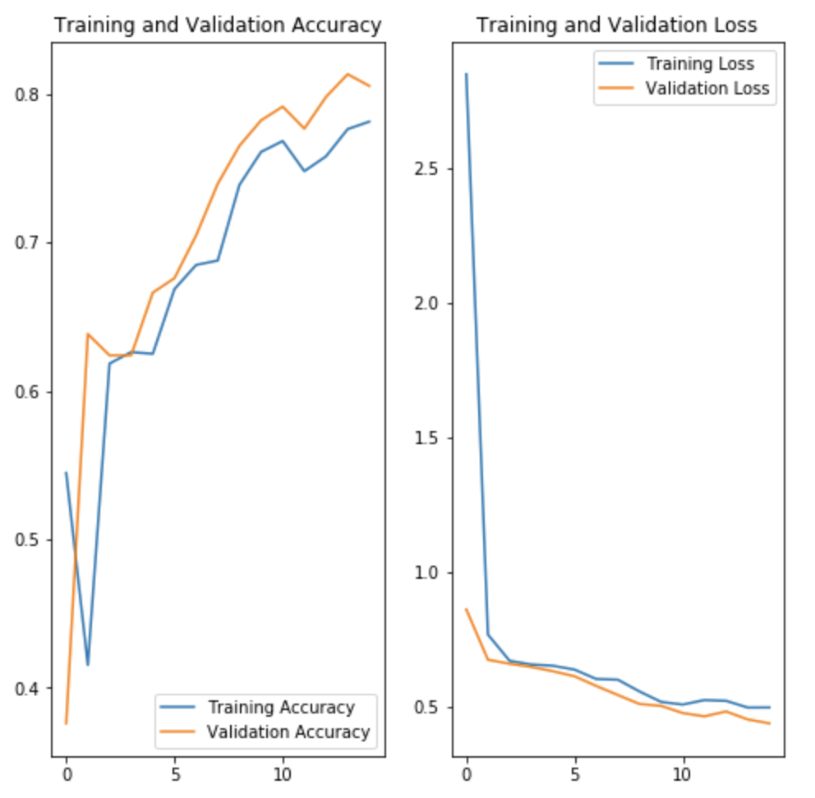
Notes:
We apply more transformation such as horizontal flip , 45 degrees of rotation randomly, Apply a zoom augmentation to the dataset to zoom images up to 50% randomly and put it together.
From the accuracy and loss plot, we can see both of them are going very well, They have a reasonable margin between training and validation dataset.Accuracy keeps going up and loss goes down

Slide 14
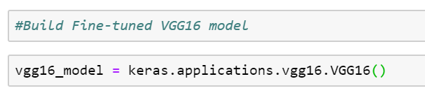
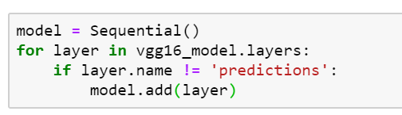
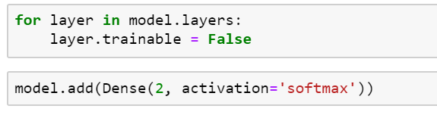
6. Fine-tune the model.
Import VGG16 model
Freeze all layers besides `predictions`
Add our layer to the model
Notes:
Next step,we apply transfer learning to fine tune the model
we import a very powerful model called VGG 16 model to apply on our dataset.we Freeze all layers besides `predictions`
Add the Dense layer with softmax activation to the model

Slide 15
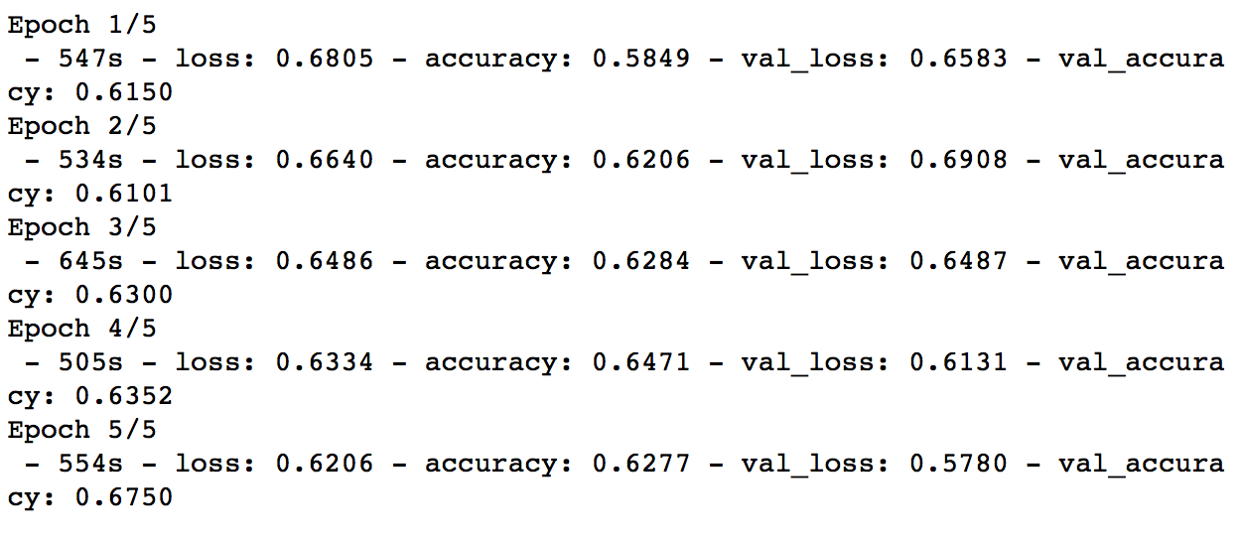
Notes:
We run through this model using 5 epoches and 700 batches for training and 100 batches for validation as before and it doesn’t look as good as we had before.
The highest accuracy for training is 64.71% and the highest accuracy for validation is 67.5%.

Slide 16
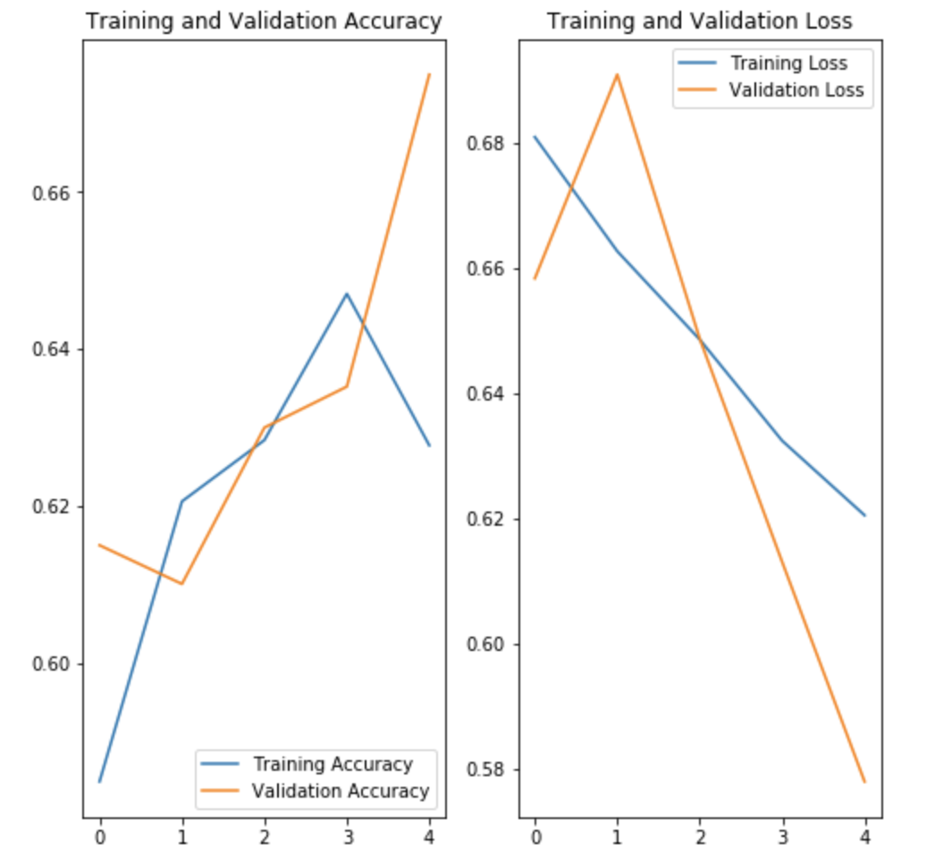
Notes:
Even though accuracy goes up and loss goes down, they have some interactions and it’s not as accurate as the previous model

Slide 17
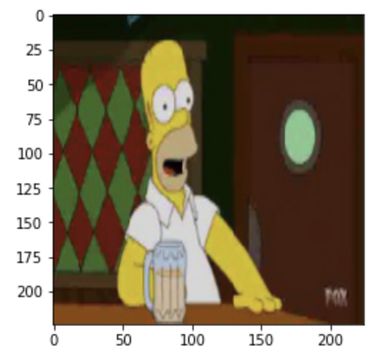
Solution
Upload an image
Resize it
Use the model to predict who is it in the image
Notes:
We use the model that has all the transformation to test the prediction.
we upload an addition image from the testset and resize it as the same size to 224 x 224 pixel image with depth = 3. So the probability of showing image to be homer is 91% and the probability of showing image to be lisa is 9.8%, which is pretty good.

